Slide 1
Digital Portfolio
STUDENT NAME: S. Srimathi
REGISTER NO AND NMID: 212405453 / D543DAA28C2D022853B4AF717851BCB3
DEPARTMENT: batcholer of computer application
COLLEGE: COLLEGE/ UNIVERSITY: aksheyaa college of arts &
science /university of madras

Slide 2
PROJECT TITLE :
🔹 Digital Portfolio

Slide 3
AGENDA
Problem Statement
Project Overview
End Users
Tools and Technologies
Portfolio design and Layout
Features and Functionality
Results and Screenshots
Conclusion
Github Link

Slide 4
PROBLEM STATEMENT
Many students find it hard to showcase skills.Resumes do not highlight creativity well.Need for a digital space to present projects.A portfolio can solve this gap.It improves academic & career opportunities.

Slide 5
PROJECT OVERVIEW
A personal website to display details.Includes About Me, Skills, Projects, Contact.Simple, clear, and professional design.Responsive on mobile and desktop.Helps in building a digital identity.

Slide 6
WHO ARE THE END USERS
Students for academic use.Job seekers for recruiters.Freelancers for clients.Professionals for career growth.Anyone who needs an online presence

Slide 7
TOOLS AND TECHNIQUES
HTML – Page structure
CSS – Styling & layout
JavaScript – Interactivity
VS Code – Development
GitHub Pages – Hosting

Slide 8
POTFOLIO DESIGN AND LAYOUT
POTFOLIO DESIGN AND LAYOUT
Sections: Home, About, Projects, Contact.Clean and user-friendly interface.Modern design with smooth navigation.Responsive for all screen sizes.Professional look & feel.

Slide 9
FEATURES AND FUNCTIONALITY
smooth navigation bar.projects with screenshots.interactive effects & animations.contact form with validation.works on all devices.

Slide 10
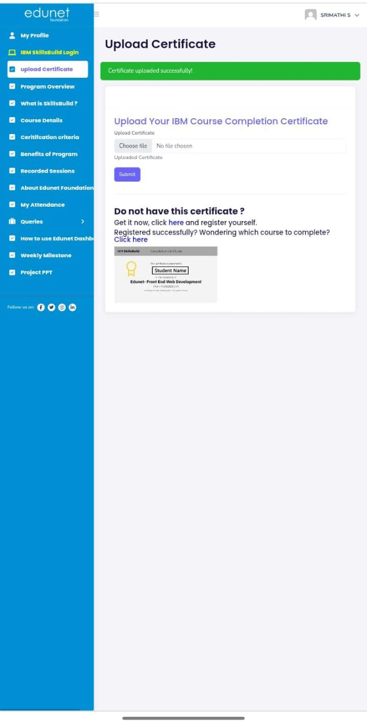
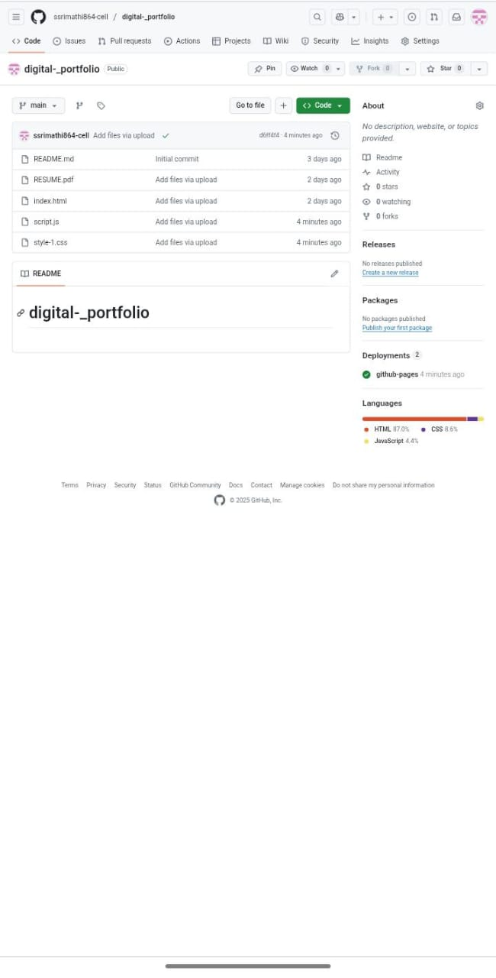
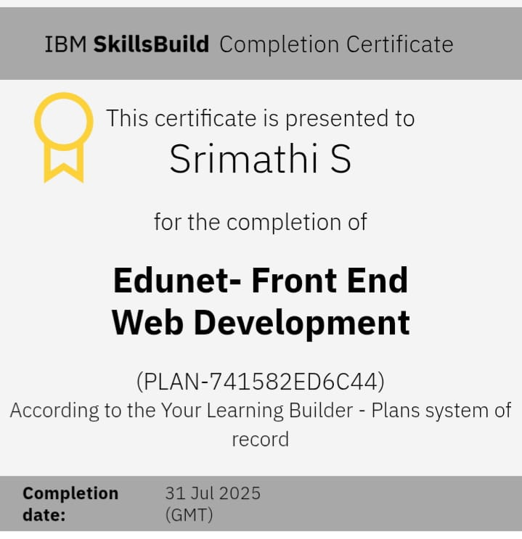
RESULT AND SCREENSHOTS
Personal Shape - Creative Designer
https://share.google/ppPRgqfE5jOKm2rQg

Slide 11
CONCLUSION
digital portfolio adds professional value.shows technical knowledge clearly.useful for academic & career growth.easy to maintain and share.future: add more features.

